Slide 1



Advance Excel
Road Accident Analysis Dashboard
Interactive Analytics for Road Safety Decisions
template.wps.com
Presentations are communication tools that can be used as speeches, reports, and more.

Slide 2

Advance Excel
Product Introduction
01
Data-driven road safety analytics dashboard
Focus on accident casualties and patterns
Designed for decision-making and portfolio use

Slide 3

Advance Excel
Domain & Platform
Domain: Road Safety & Transportation Analytics
Platform: Microsoft Excel dashboard solution
Method: KPI-driven visual analysis approach

Slide 4

Advance Excel
01
Accident data is large and complex
Problem Statement
02
Lack of centralized visual reporting system
03
Difficult to identify high-risk patterns quickly
04
Icon-based visual representation

Slide 5

Project Objectives
Advance Excel
02
03
Identify high-risk accident conditions
Compare yearly accident trends
01
04
Analyze accident casualty trends
Support safety-focused decision making

Slide 6
Advance Excel
03
Dataset Overview
Single, cleaned accident dataset
Includes monthly and yearly accident records
Covers year, vehicle, road, and light conditions

Slide 7




Dashboard Structure
Advance Excel
01
03
KPI summary cards at top
Trend analysis visuals
02
04
Interactive filters and slicers
Category-wise visual charts

Slide 8

Advance Excel
Primary KPI’s
Total accident casualties
Fatal accident casualties
Serious injury casualties
Slight injury casualties
Car-related accident casualties

Slide 9

Severity Analysis
Advance Excel
01
Fatal vs Serious vs Slight injuries
02
Donut charts showing percentage share
03
Helps prioritize safety focus areas

Slide 10

Vehicle Type Analysis
Advance Excel
01
02
Cars accident casualties
Motorcycles accident casualties
8000+
16400km
03
04
Trucks and Buses accident casualties
Tractor accident casualties

Slide 11
Advance Excel
CY vs PY Trend Analysis
Monthly casualty comparison
Current Year vs Previous Year
Line chart visualization

Slide 12




Road Type Analysis
Advance Excel
Single carriageway roads
Dual carriageway roads
Roundabout roads
Oneway street roads
Slip road and unknown
Horizontal bar chart

Slide 13
Advance Excel
Road Surface Analysis
Dry road conditions
Wet road conditions
Snow conditions
Vertical Column chart

Slide 14
Advance Excel
01
Area-wise Analysis
Urban vs Rural casualties
Pie chart comparison
Urban areas show higher casualties

Slide 15
Light Condition Analysis
Advance Excel
01
Daylight accident cases
02
Darkness accident cases
03
Area chart visualization

Slide 16
Filters & Interactivity
Advance Excel
10%
01
Year-based slicer
40%
04
Wind condition filter
20%
02
Weather condition filter
30%
03
Dynamic dashboard updates

Slide 17
Advance Excel
01
Slight injuries account for most casualties
Key Insights
02
Cars contribute the highest accident count
03
Single carriageway roads are high-risk
04
Most accidents occur during daylight

Slide 18
Advance Excel
Business Value
Supports road safety planning
Identifies accident-prone conditions
Enables quick, data-driven decisions

Slide 19


Tools & Features Used
Advance Excel
Microsoft Excel
Power Query & Data Cleaning
Pivot Tables and Pivot Charts
Slicers for interactivity
Icons and shapes for storytelling
WPS Office Presentation
GitHub
Tools & Features Used

Slide 20

Conclusion
Advance Excel
02
Strong dashboard storytelling approach
01
03
Complete end-to-end Excel analytics project
Suitable for Data Analyst and MIS roles

Slide 21

Project Preview
template.wps.com

Slide 22
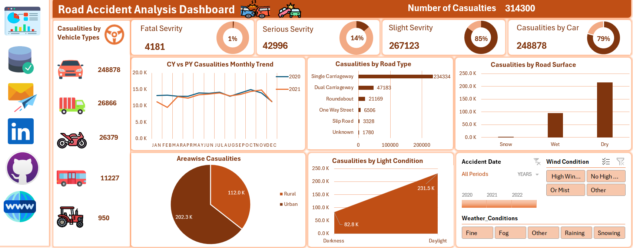
Final Dashboard
Project Preview
template.wps.com

Slide 23








Follow me
In Professional Platforms
LinkedIn
GitHub
X
Mail
Website

Slide 24
Thank You!
Every great presentation is complete with a great audience — and that’s you!
Thank you for your attention!
For feedback, improvements, or project collaboration:

